Slide 1
Gun Violence in Minnesota
University of Minnesota Data Analytics and Visualization
By: “Alice” Lan Nguyen, Arnold Miranda Reynoso, Jacob Anderson, & MaiDao Lor

Slide 2
THE DICKEY AMENDMENT
This prevented the use of federal funds to “advocate or promote gun control”
2020 was the first year since 1996 that the federal budget included funds to research reducing gun-related deaths and injuries
Notes:
This was implemented in 1996, and had some restrictions released in 2012 and 2018 due to mass shootings, but there wasn’t any funding put towards the type of data we were looking for until 2020, so I would be interested to see if we did this project 5-10 years from now if the government data would be more thorough or cover a larger scope than the data we have here, or if it would be largely the same.

Slide 3
INTRODUCTION
We’ve obtained our dataset from Kaggle, namely the “Gun Violence Data” and “US Population by State.” The CSV file contains data pertaining to every documented incident of gun violence in the US between January 2013 to March 2018. The dataset comes from the nonprofit Gun Violence Archive.
Our Analysis will focus on the geographical distribution of gun-related incidents within the states of California, Oregon, Minnesota, Illinois, New York, Maine, Florida, and Alabama.
Lastly, our analysis will include a comparative examination of trends over a specific year relative to the entirety of the dataset’s timespan. This approach will enable us to gain valuable insights into the development of gun-related incidents over time.

Slide 4
Our Questions
01
02
03
Where is Gun Violence Most Likely to Happen?
How much does the population of the area affect the total?
Are There any Trends over the Course of a Year?
How will the school year affect violence totals?
Are There any Trends over the Course of Multiple Years?
Is there an Increase over time? A Decrease?
Notes:
The first three questions are on a macro level comparing Minnesota to the rest of the states, the third question is on a micro scale looking at just Minnesota

Slide 5
PROBLEMS WE ENCOUNTERED
Managing Our Dataset
We cannot map all the data
Solution: We narrow the dataset to 8 states of interest: Minnesota, California, Oregon, Main, New York, Florida, Illinois and Alabama
Defining Mass Shooting
No clear definition
Solution: We decided to use the FBI definition which is 4 or more deaths in the incident
Defining the School Year
It varies by state and age
Solution: Because of our project’s focus on Minnesota, we decided to use the months from September to May as the guideline
Notes:
I know those second two weren’t significant issues, but we can definitely hype them up a bit

Slide 6
ETL PROCESS
EXTRACT
TRANSFORM
LOAD
Download the two datasets from Kaggle
Merge Datasets
Remove Unnecessary Data
Update Column Names and Data Types
Create a Second Dataset
Load the two datasets into Postgres

Slide 7
01
GUN VIOLENCE
Where is Gun Violence most Likely to Occur?

Slide 8
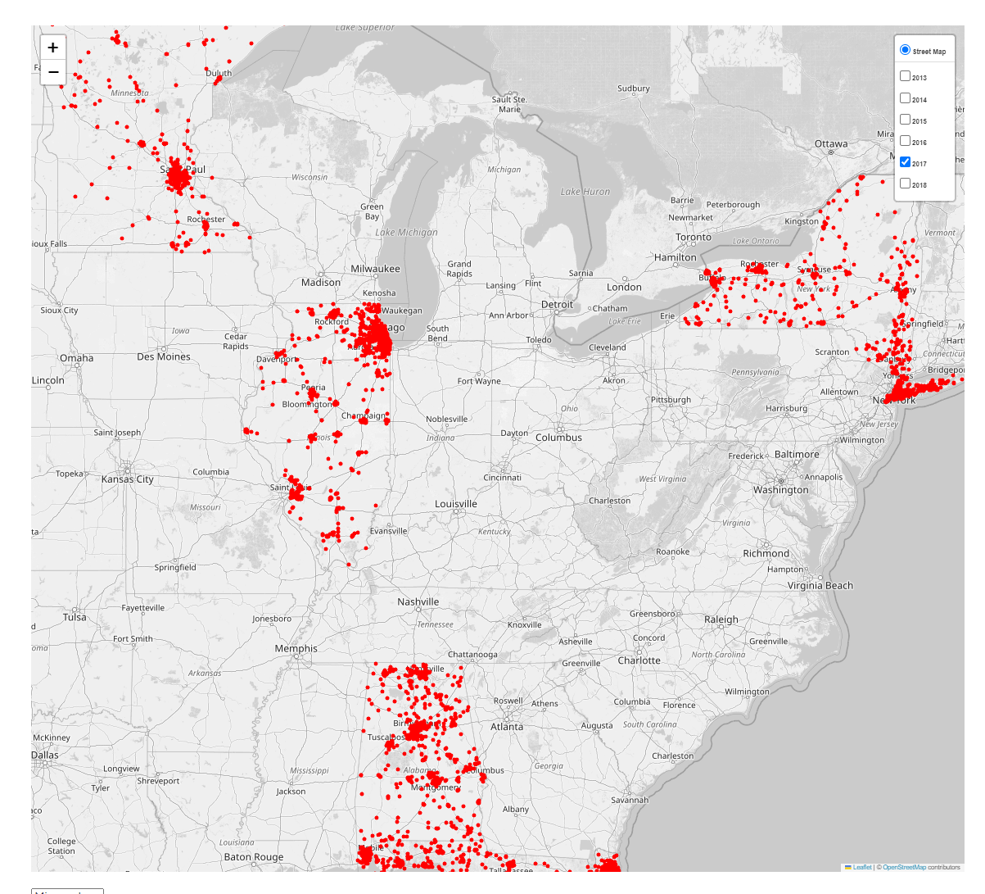
Where is gun violence most likely to happen?

Slide 9
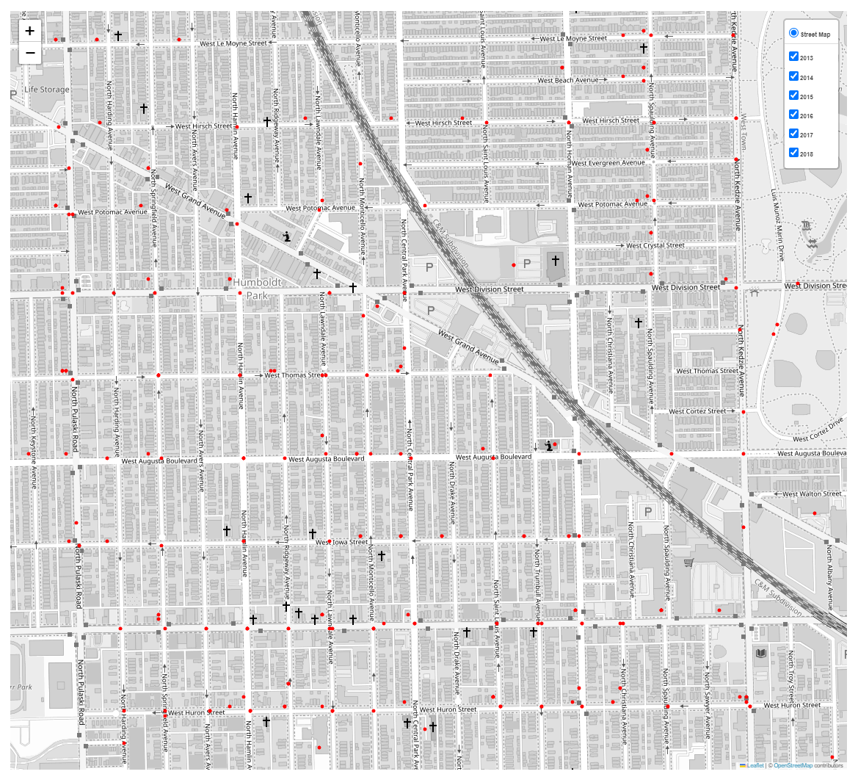
Gun incidents In Chicago

Slide 10
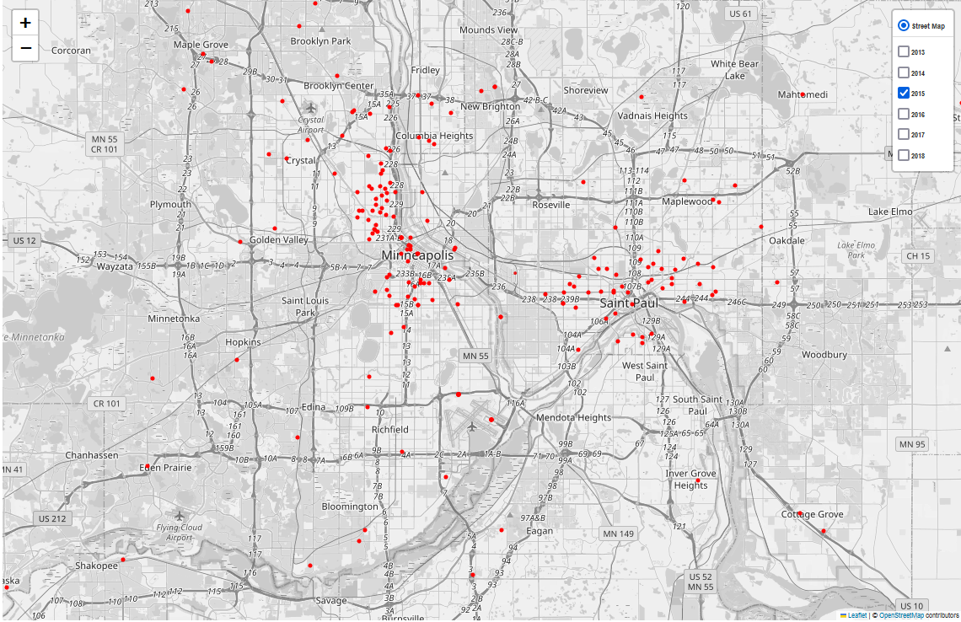
Gun Violence in the Twin Cities

Slide 11
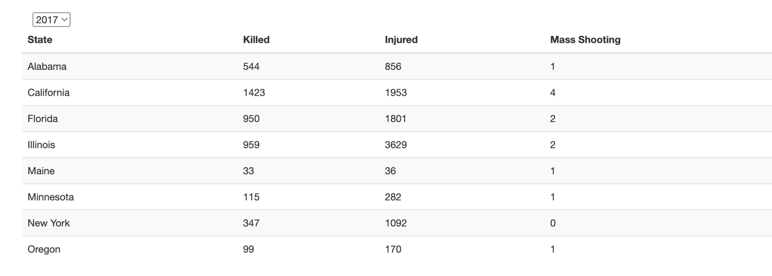

Slide 12
02
Yearly Trends
Does Gun Violence Increase During the School Year?

Slide 13
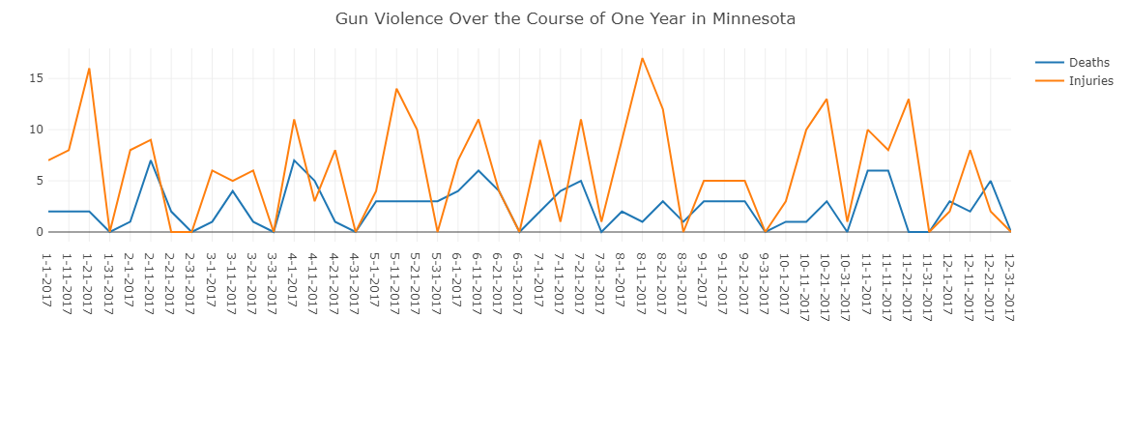
There doesn’t appear to be any noticeable trends in this graph

Slide 14
03
THE BIG PICTURE
03
Are There any Trends Over Multiple Years?

Slide 15
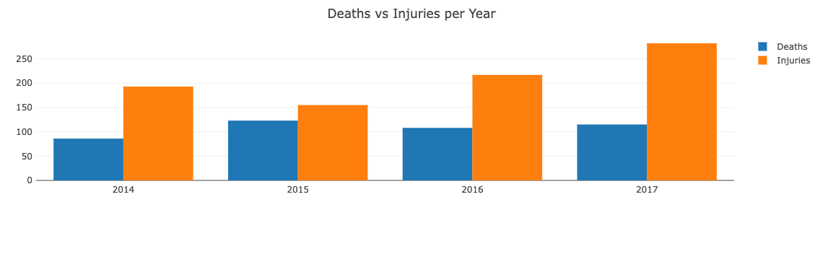
You can see a sizable increase in injuries
There is a steady growth in deaths as well
2015 is a bit of an outlier for both

Slide 16
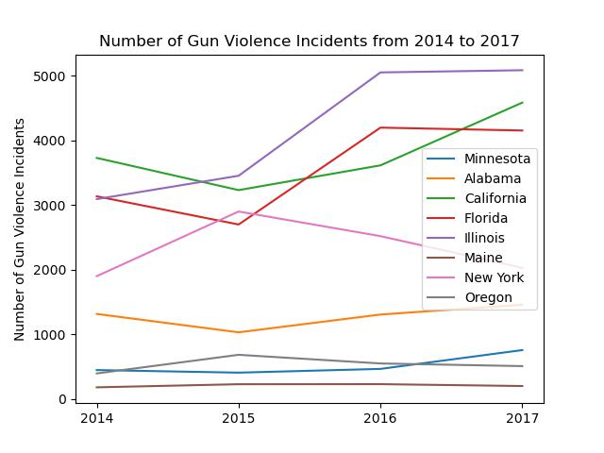
POPULATION
The more populous states clearly have a significantly higher number of incidents
ANOVA TEST
Our ANOVA Test had a P Value of 2.22e^-11

Slide 17
PER 100,000 COMPARISON
Ignoring Big Populations

Slide 18
STATE POPULATION
Maine: 1.3 Million
Oregon: 4.1 Million
Alabama: 4.8 Million
Minnesota: 5.5 Million
Illinois: 12.8 Million
New York: 19.6 Million
Florida: 20.5 Million
California: 38.9 Million
 | AVERAGE DEATHS (Per 100,000) | AVERAGE INJURIES (Per 100,000) | AVERAGE COMBINED (Per 100,000)
MAINE | 2 | 2.5 | 4.5
OREGON | 2.5 | 4 | 6.5
ALABAMA | 9.1 | 14.4 | 23.5
MINNESOTA | 2 | 3.9 | 5.8
ILLINOIS | 6.3 | 25.1 | 31.4
NEW YORK | 2.1 | 6.2 | 8.3
FLORIDA | 4.4 | 8.1 | 12.5
CALIFORNIA | 3.3 | 4.5 | 7.9

Slide 19
CONCLUSION
What Did We Learn?

Slide 20
Our Answers
01
02
03
Where is Gun Violence Most Likely to Happen?
Populous City Centers
Are There any Trends over the Course of a Year?
It doesn’t appear that way
Are There any Trends over the Course of Multiple Years?
There is a noticeable and significant increase over time
Notes:
The first three questions are on a macro level comparing Minnesota to the rest of the states, the third question is on a micro scale looking at just Minnesota

Slide 21
NEXT STEPS
What would we do if we researched further?

Slide 22
NEXT STEPS
MORE STATES
LARGER TIME FRAME
PATCH HOLES
Due to our computing restrictions, we only covered eight states
Finding data for this topic can be difficult, especially consistent data over time
We were missing some data in 2013 and 2018

Slide 23
THANKS!
Does anyone have any questions?
Thank you so much to our wonderful Instructors who were so helpful for us over this process!

Slide 24
CREDITS
Instructor: Hunter Hollis
TAs: Sam and Randy
https://getbootstrap.com/
https://github.com/dmcneill0711/Mass-Shootings-and-Children/blob/main/Mass%20Shootings%20Project.ipynb
https://stackoverflow.com/questions/12906351/importerror-no-module-named-psycopg2
https://stackoverflow.com/questions/61018823/programmingerror-psycopg2-errors-undefinedcolumn-while-working-with-sqlalche

